Slide 1

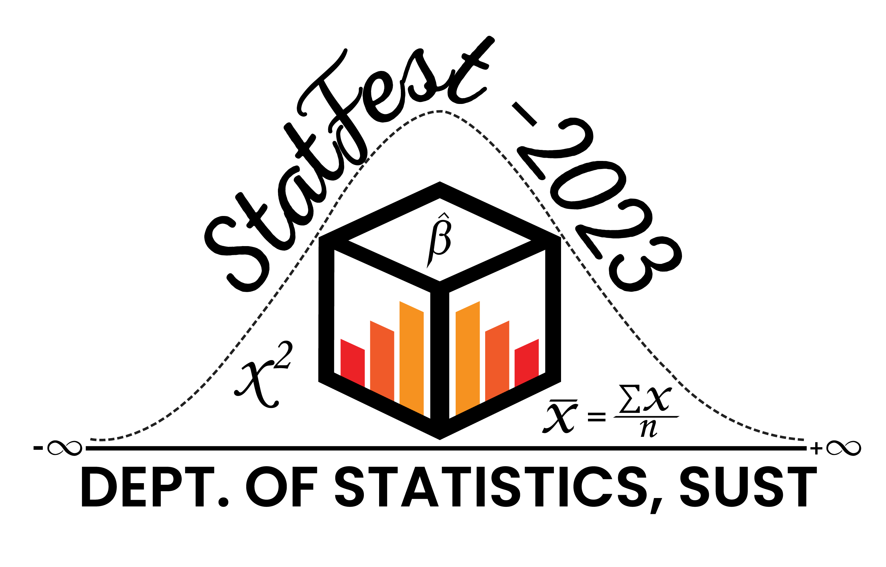
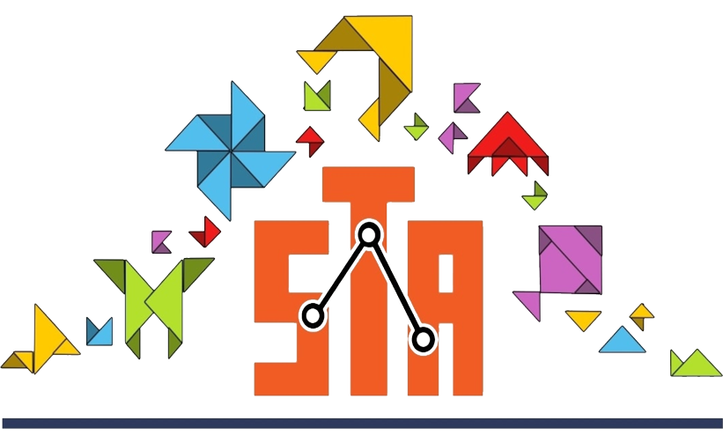
Socio-Demographic Factors Along with COVID-19 Effect Associated with Suicide : In Rural Community of Bangladesh
Tamim Tanha Alam, Nasimul Islam, Tahsina Islam, Nazmus Sakib
1.3rd Year 1st Semester, Department of Statistics, Shahjalal University of Science and Technology, Sylhet
OBJECTIVE
The objective of the study was to assess the relationship between socio-demographic factors and suicide. Also the relationship between COVID-19 effect with suicide.
BACKGROUND
In the modern urbanised world, mental distress causing to have suicidal thoughts is a well analysed subject. However, the same discussion somehow leaves out the vast majority of people living in rural areas. So we wanted to observe the suicidal tendencies of these people, more so after the severe effects of the COVID-19.
METHODS
A cross-sectional study was conducted on people aged between 18 to 59 year from the Pabna district’s Bera Upazila from which we have taken 467 reponses as secondary data after data cleaning.
The main study variable ‘Suicidal Status’ consists of the set of respondents who have planned or attempted suicide in their lifetime.
To assess suicidal behaviour, we used Chi-square test to test the significance with the socio-demographic factors and the COVID-19 factors associated with suicide using IBM SPSS 25 to analyze the data.
RESULTS
Among our 13 socio-demographic variables, 8 variables are significantly associated with suicidal status where age(p=0.057) is significant at 10% level of significance and other variables are at 5% level of significance. Suicidal Status is observed to be highly effected by family mental health history(p=0.001) and family history of COVID-19 death(0.005). We have found from our study that approximately 6% respondents have had suicidal tendencies regarding these factors.
Table: Association between Socio-demographic factors, COVID-19
effect with Suicidal Status
CONCLUSION
We can conclude that a big portion of rural community also face high risk of suicidal tendency. Terrifying incident e.g., Family history of COVID-19 death has increased the risk of the possibility of attempted suicide. So , it is high time to start suicide prevention programs considering the vulnerable cohort of rural communities.
REFERENCE
Prevalence and associated factors of suicidal behaviors among Bangladeshi rural community people: Findings from the ‘BD ComMen Study’ Mohammed A. MamunID1,2,3*, Firoj Al-MamunID1,2,3, Johurul Islam3,4, Mohammad Muhit3,4 1 CHINTA Research Bangladesh, Savar, Dhaka, Bangladesh, 2 Department of Public Health & Informatics, Jahangirnagar University, Savar, Dhaka, Bangladesh, 3 Department of Public Health, University of South Asia, Dhaka, Bangladesh, 4 CSF Global, Banani, Dhaka, Bangladesh.
CONTACT US : tamim09@student.sust.edu

